Slide 1
AR SDK’s
Robby Kennedy

Slide 2
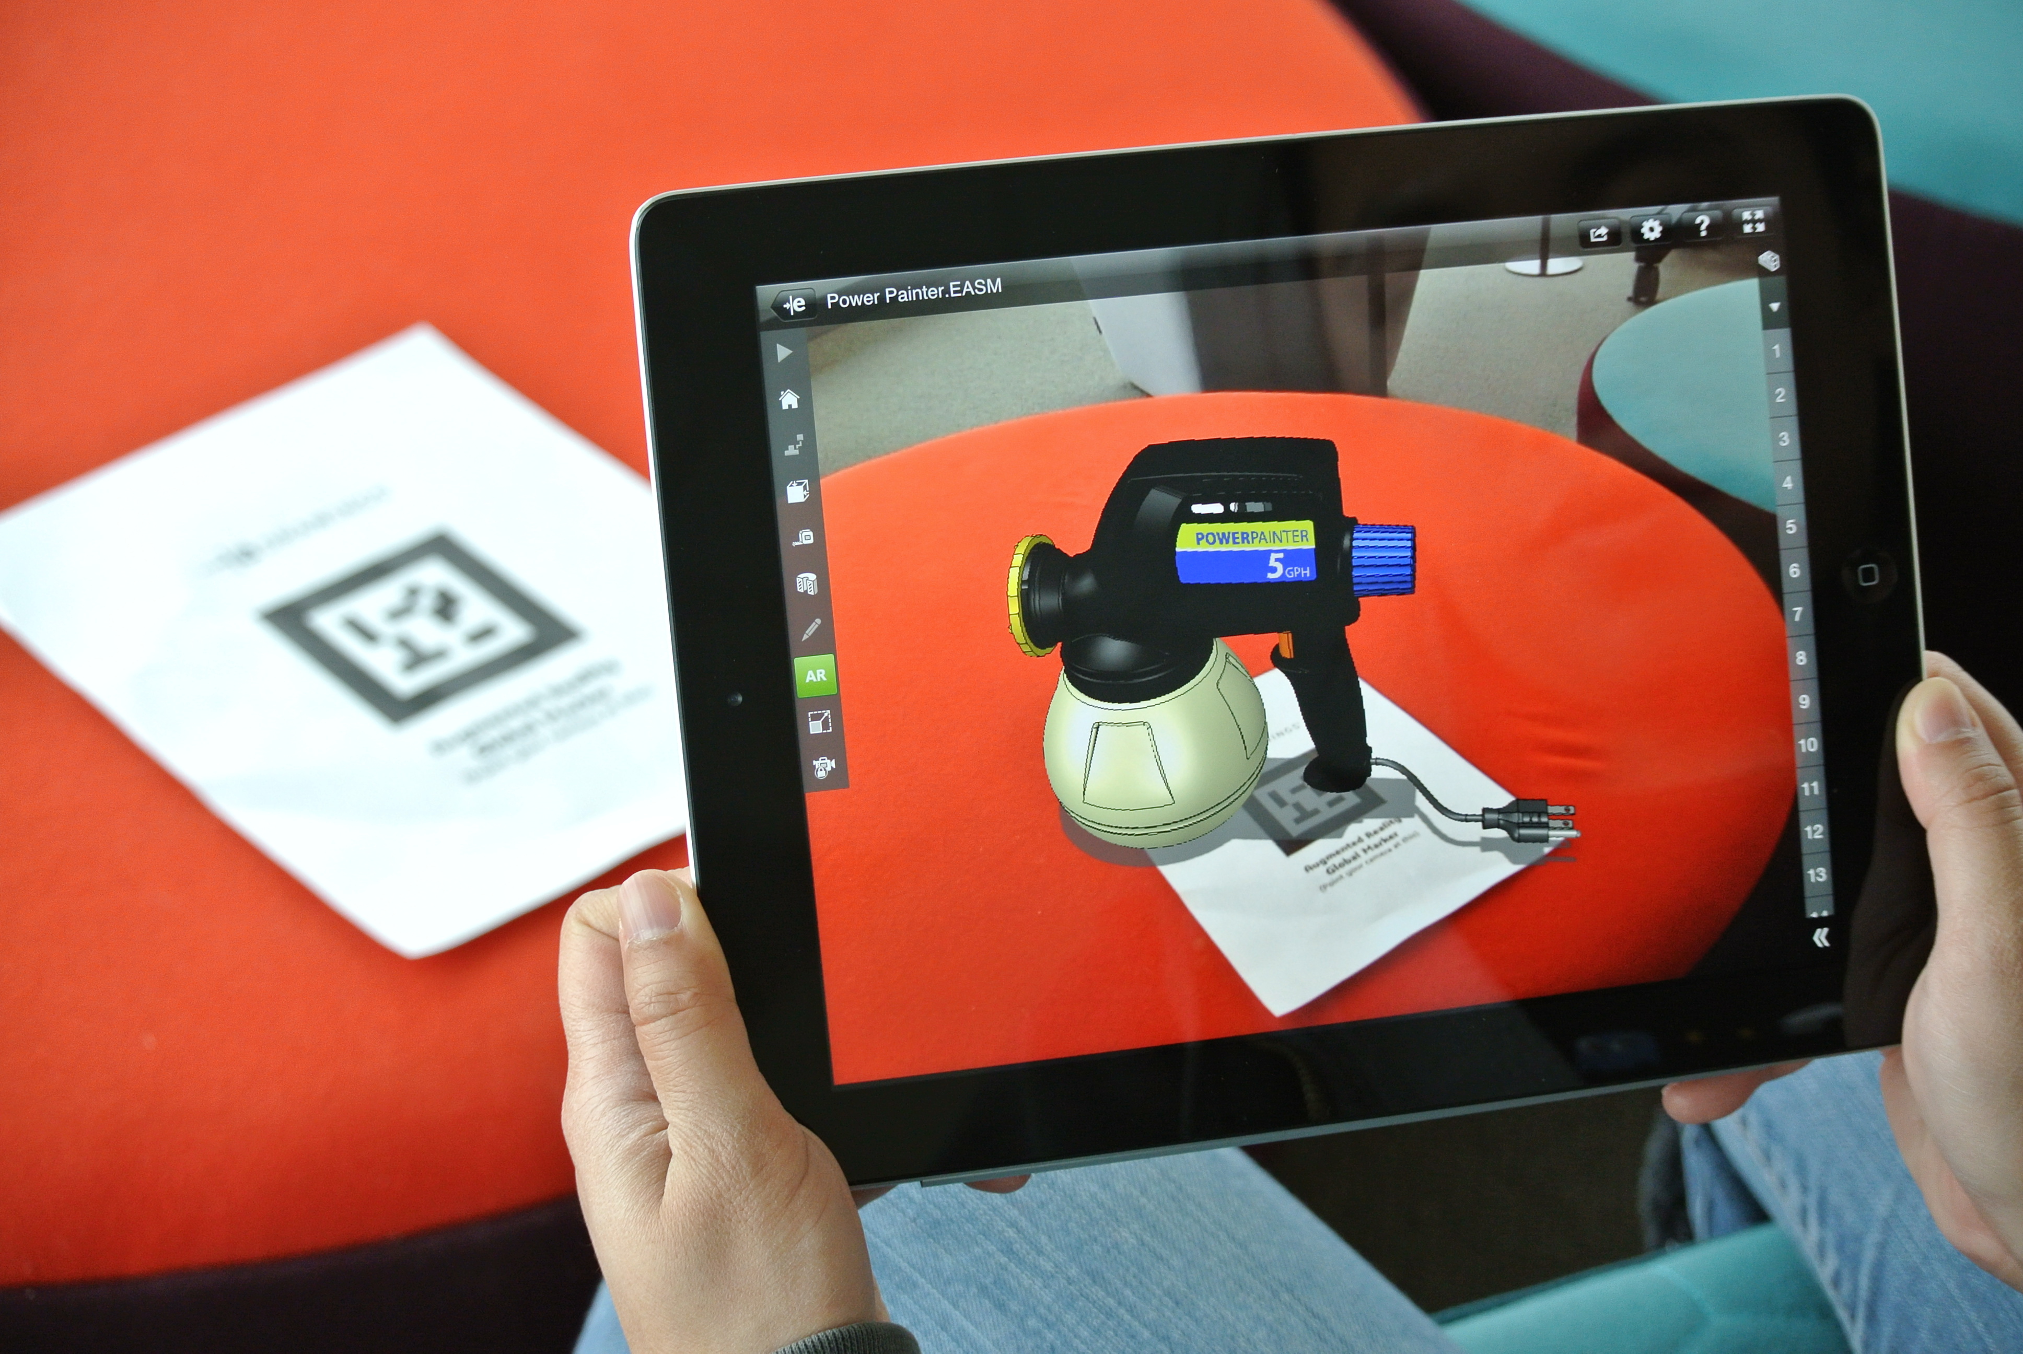
Components of AR SDK
Image recognition engine
3D/2D object rendering
Accelerometer integration
Rotate object accordingly

Slide 3
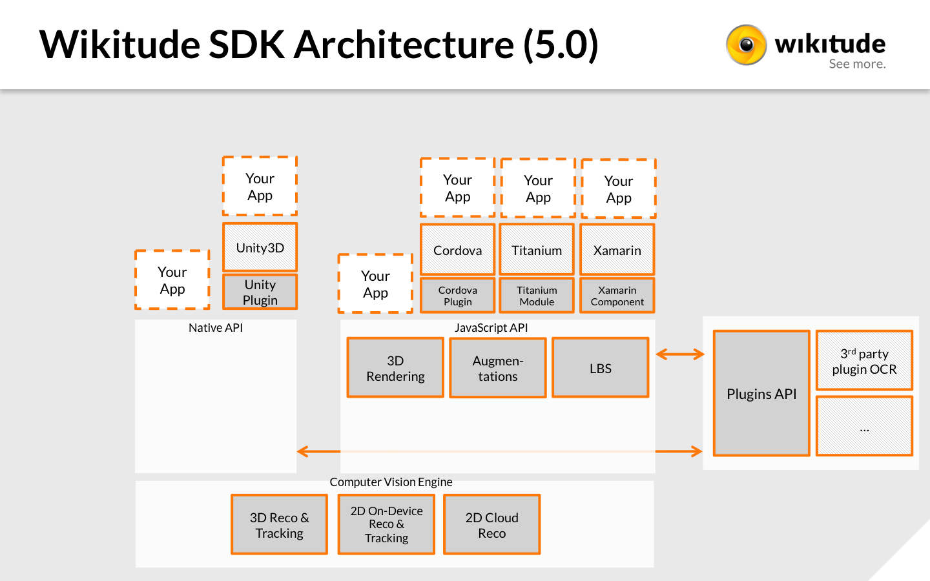
Integrating with Mobile
Complete SDK’s have Native API’s
Wikitude | Catchoom
Using JAVA for Anrdroid
Plugins for Unity
Wikitude | Vuforia | ARToolKit (open source)
C# or Javascript

Slide 4
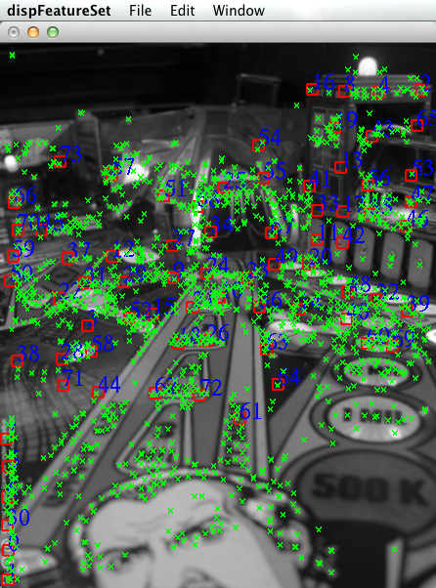
Target Creation
Image recognition engine is the heart of AR
Targets are any image
Looks for features in image
QR code style image work very well
But are ugly…
Images have to immutable
Printed on rigid surface
A poster works well
A flag is virtually unusable

Slide 5


Target Quality
Good
Detail
Contrast
Features
Sharp lines (cartoons work well)
Bad
Gradients
Text only
Limited features

Slide 6

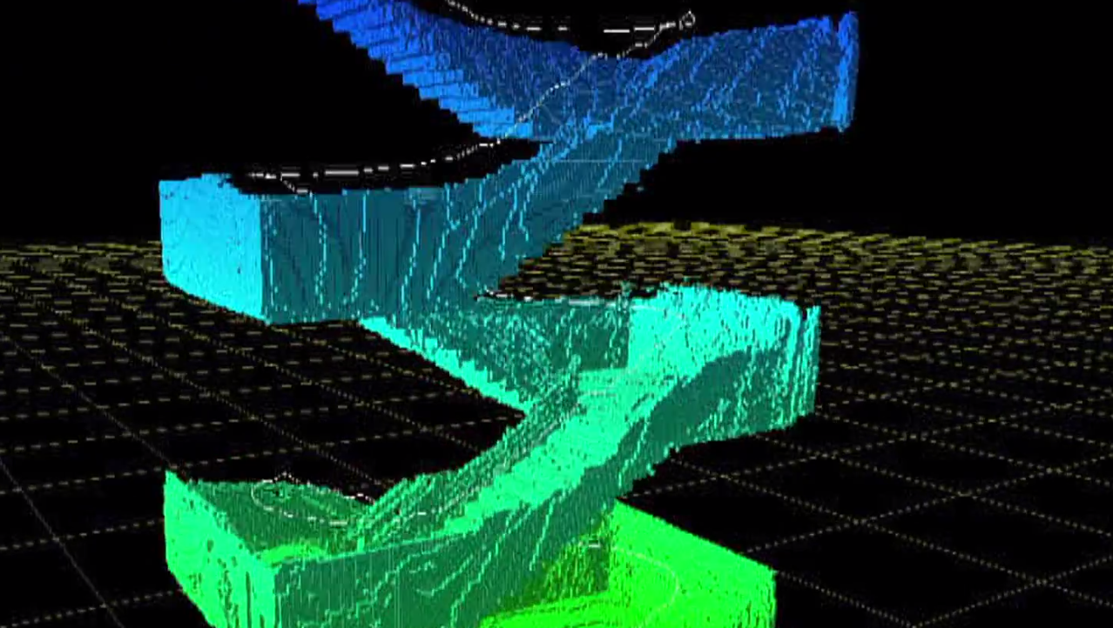
3D Environment Tracking (SLAM)
Some AR tools can track real world objects
SLAM is the name
Simultaneous Localization And Mapping
Quite limited/buggy
Most devices are limited to 1 RGB camera
Required ‘scanning’ of object with SDK tools
Exact 3D model can be used for target
Object also needs to be immutable

Slide 7
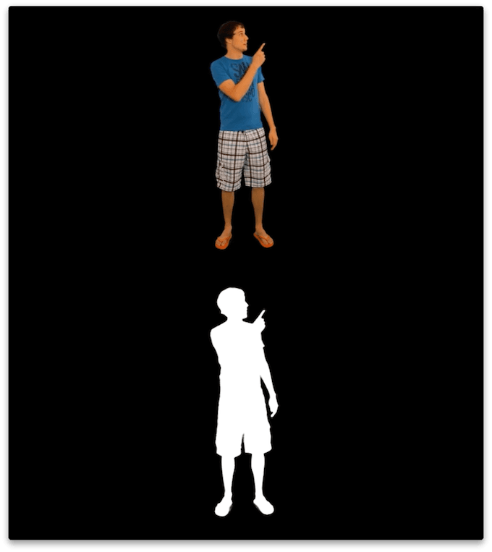
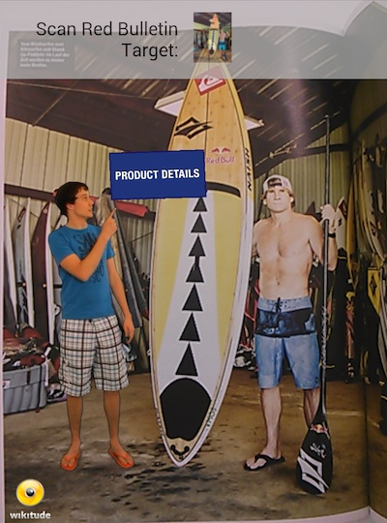
Asset Creation
Videos
Alpha channels do work
Images
Any editor with transparent .png exporting
Transparency gradients work nicely (.png)

Slide 8
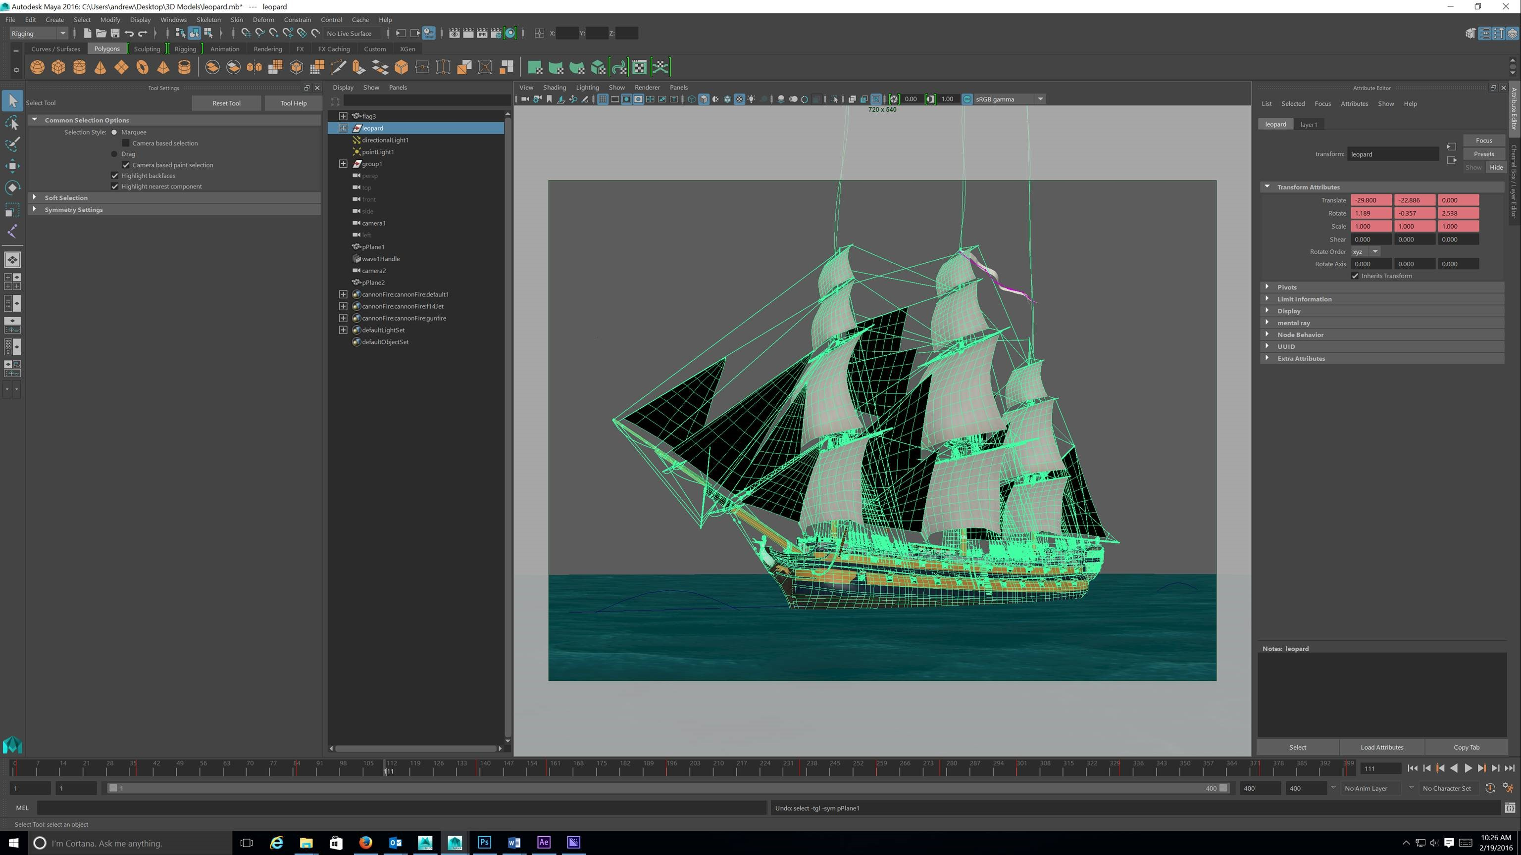
Asset Creation Con’t
3D Models
Maya | Blender | Stock 3D Models
Stock/Open Source
Stand alone models
3D environments don’t work well, but it’s AR, that’s what the “Real World” is for

Slide 9
Licensing….
Most comprehensive SDK’s have a price tag
Wikitude
Our’s is 5K/year
Catchoom
$Thousands
Vuforia
$500 an app
ARToolKit
Free because open source is awesome

Slide 10
Licensing…
Wikitude does have a Free version
At the cost of a Watermark (in AR viewer only)
ARToolKit is open source, so free
Wikitude and Catchoom do have educational programs
Just have to apply with student email/professor contact info
We can help

Slide 11
Examples | Tutorials
All SDK’s and tools listed have expensive examples
Wikitude has a working Android app to download
Each SDK’s website have tutorials for each specific platform
Some have video tutorails
Stackoverflow | Forums

